Slide 1

Modeling response uncertainty
Modeling Uncertainty in the Earth Sciences
Jef Caers
Stanford University

Slide 2
Modeling Uncertainty in the Earth Sciences
High dimensional
Low dimensional

Slide 3
Characteristic of Earth Science modeling
Uncertainty on “the Earth” is huge (basically infinite)
Earth models are complex and large
Building Earth models is relatively fast (CPU-wise)
Response function are often physical models (weather, climate, flow, wave propagation etc…) and can be very CPU-demanding
What do we do in such case ?

Slide 4
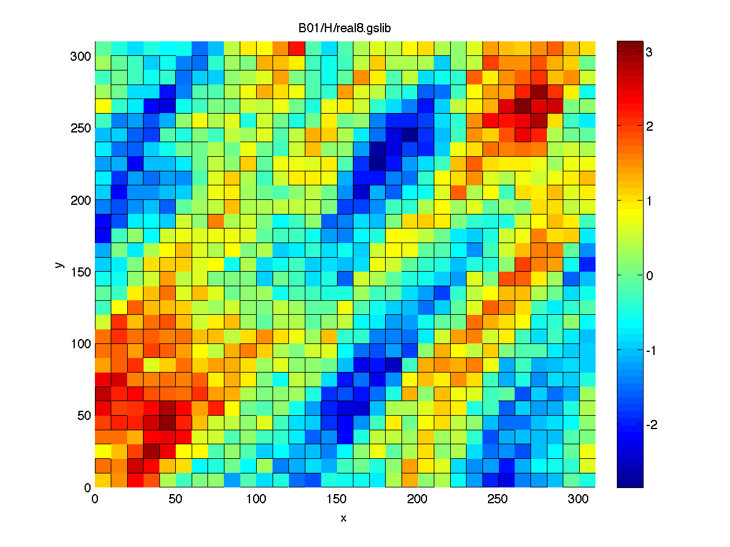
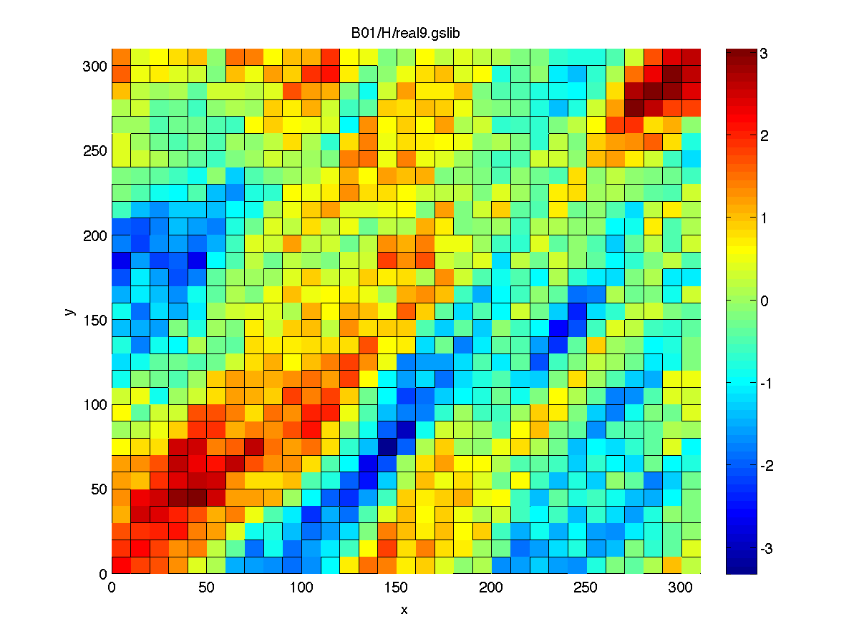
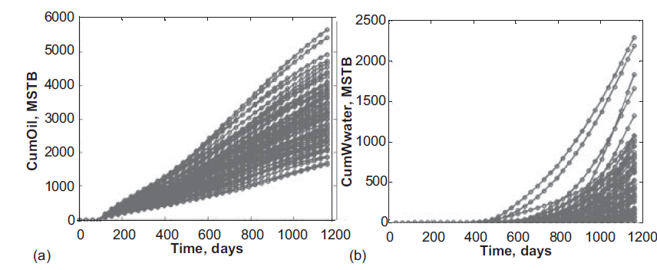
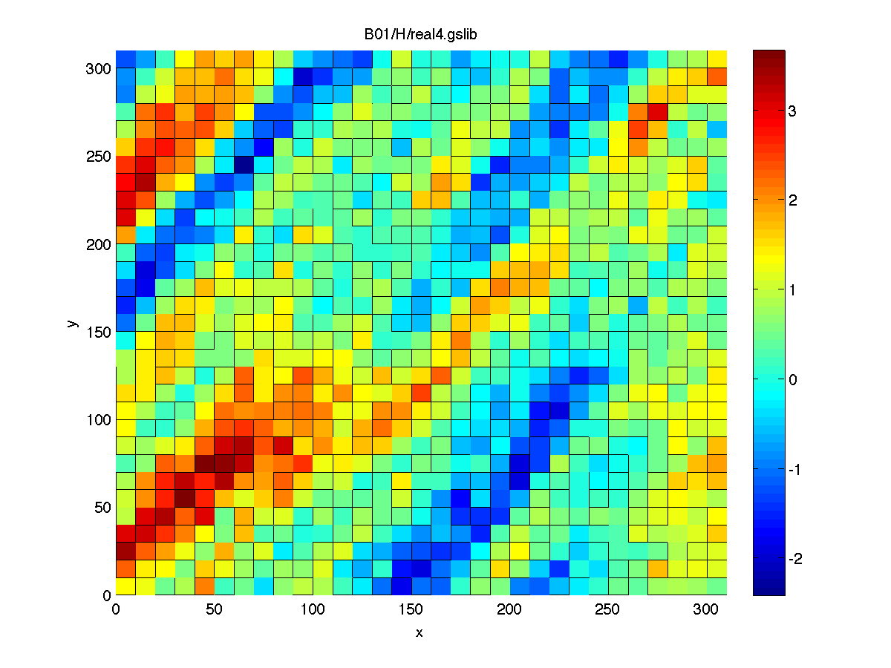
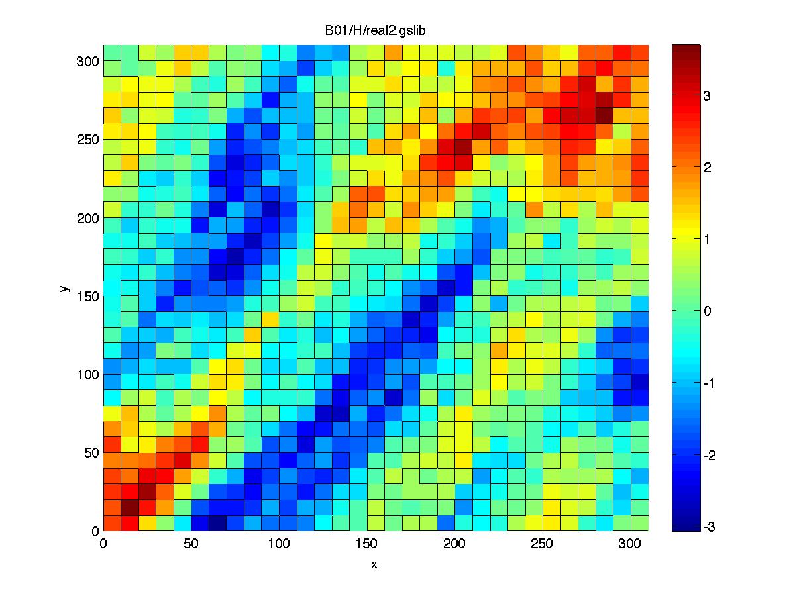
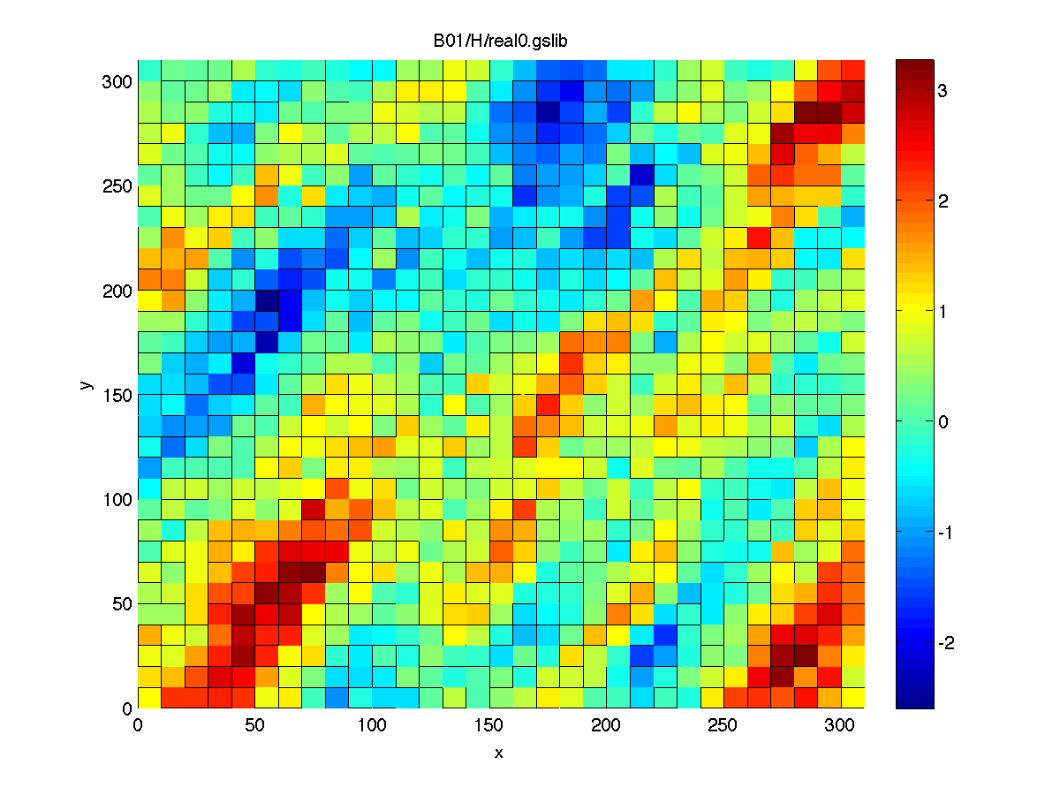
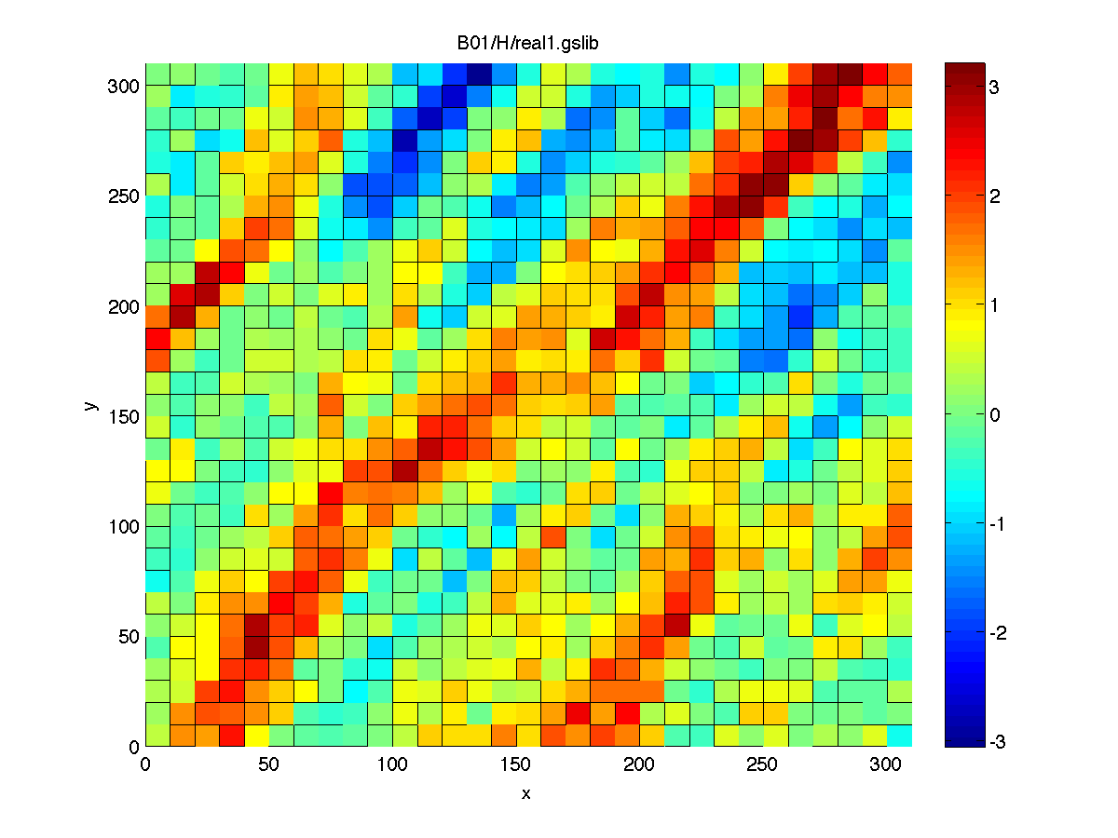
Example
Response evaluation:
CPU = Hours
Location of wells
Earth model generation:
CPU = Minutes

Slide 5
Ranking
Use an approximate physical model (proxy) to evaluate each Earth model for its response
Rank the models according to the proxy model evaluation
Select the Earth models corresponding to the quantiles evaluated with the proxy model (e.g. deciles; P10, P50, P90)
Run the actual physical model on the selected Earth models

Slide 6
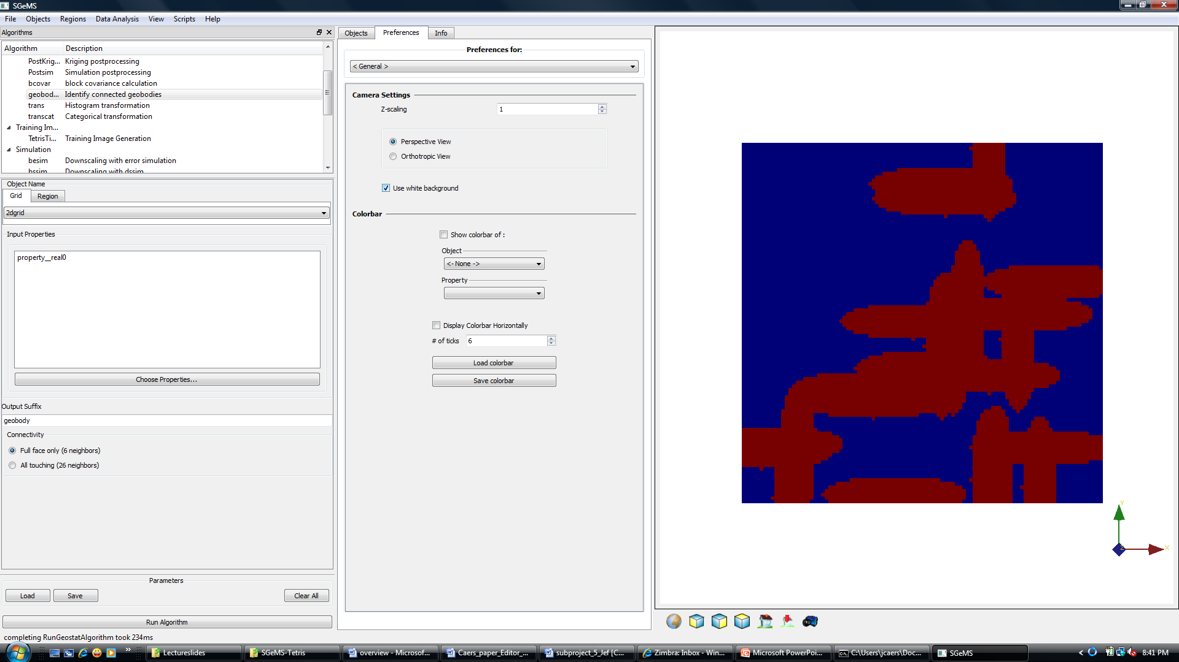
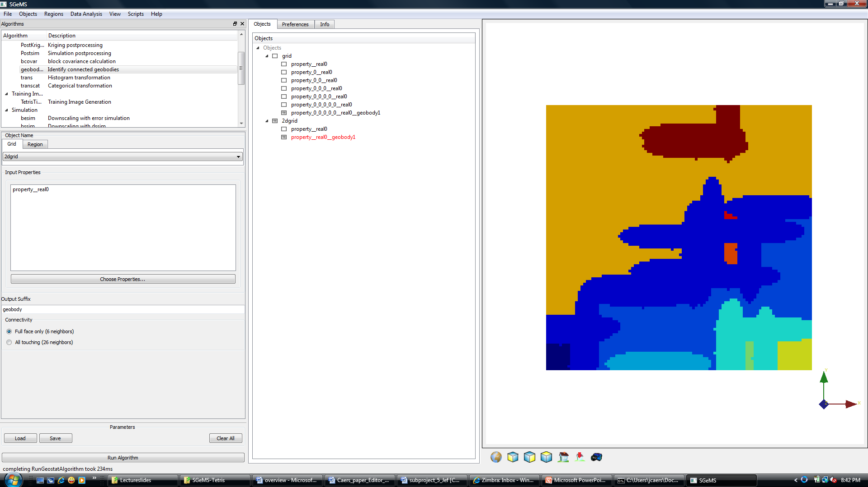
Example of ranking tool: geobodies
Earth Model
“Geobodies”

Slide 7
Experimental Design (ED)
“Experimenter”: in our case, the person modeling
The “treatment”: the effect of some process, in our case the effect of parameter choices on the response
The “experimental units”: the objects of that treatment
What combination of parameters should we chose, if we cannot chose all possible combinations ?

Slide 8
ED nomenclature
A factor: in our case a parameter, number = k
A level: how that parameter is discretized, number of categories = s
Full factorial design = s^{k} combinations

Slide 9
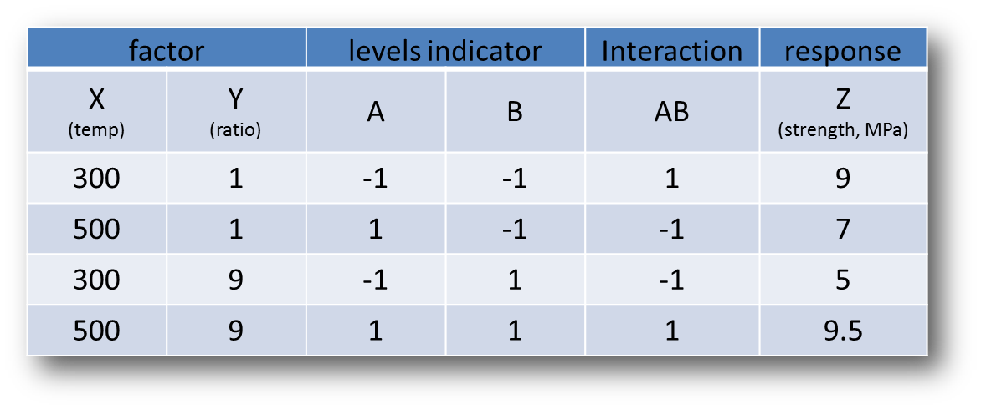
Example 2² factorial design
Testing rock strength
ratio = sand/shale ratio

Slide 10
Effect estimates

Slide 11
Type of designs
Factorial design: s^{k}
Fractional factorial design: s^{(k-p)}
Central composite design

Slide 12
Fractional factorial design
Fractional factorial design 2⁽³⁻¹⁾

Slide 13
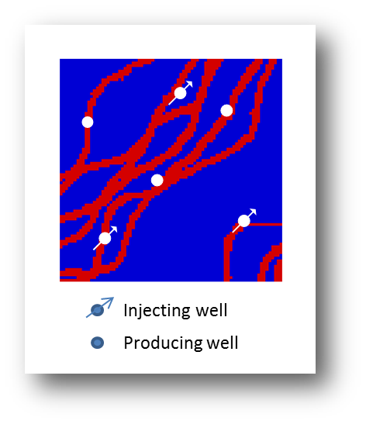
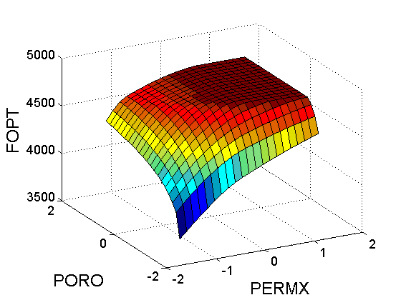
Response surface designs
A response surface
How many pairs of PORO/PERM do I need to get this surface as accurately as possible
What combination of PORO/PERM values should I chose ?

Slide 14
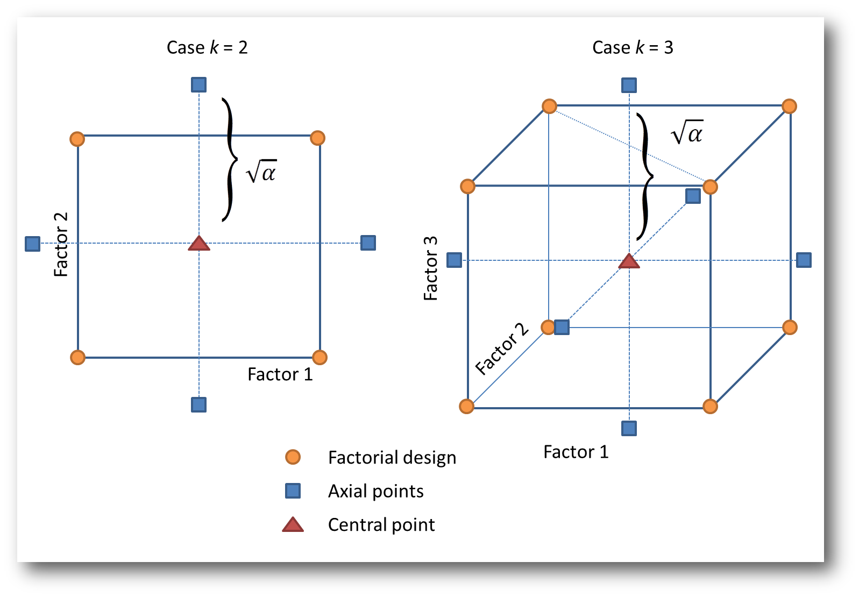
Central composite design
Total combinations = 9
Total combinations = 15

Slide 15
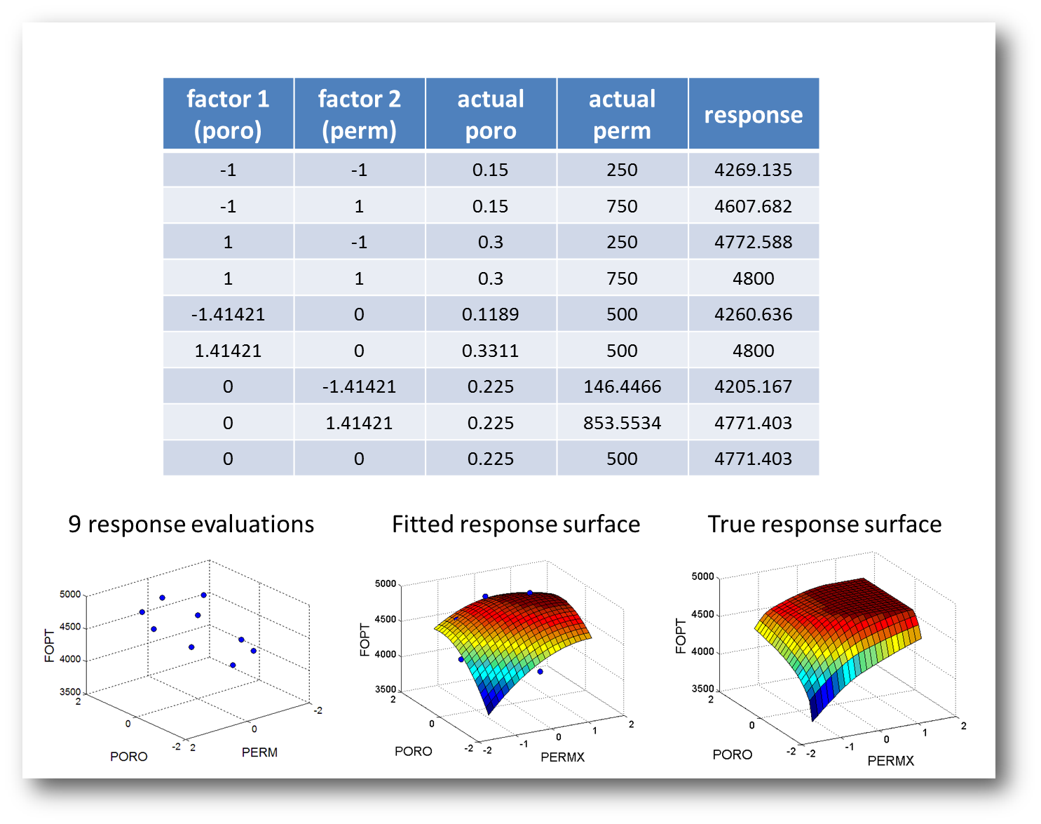
Example

Slide 16
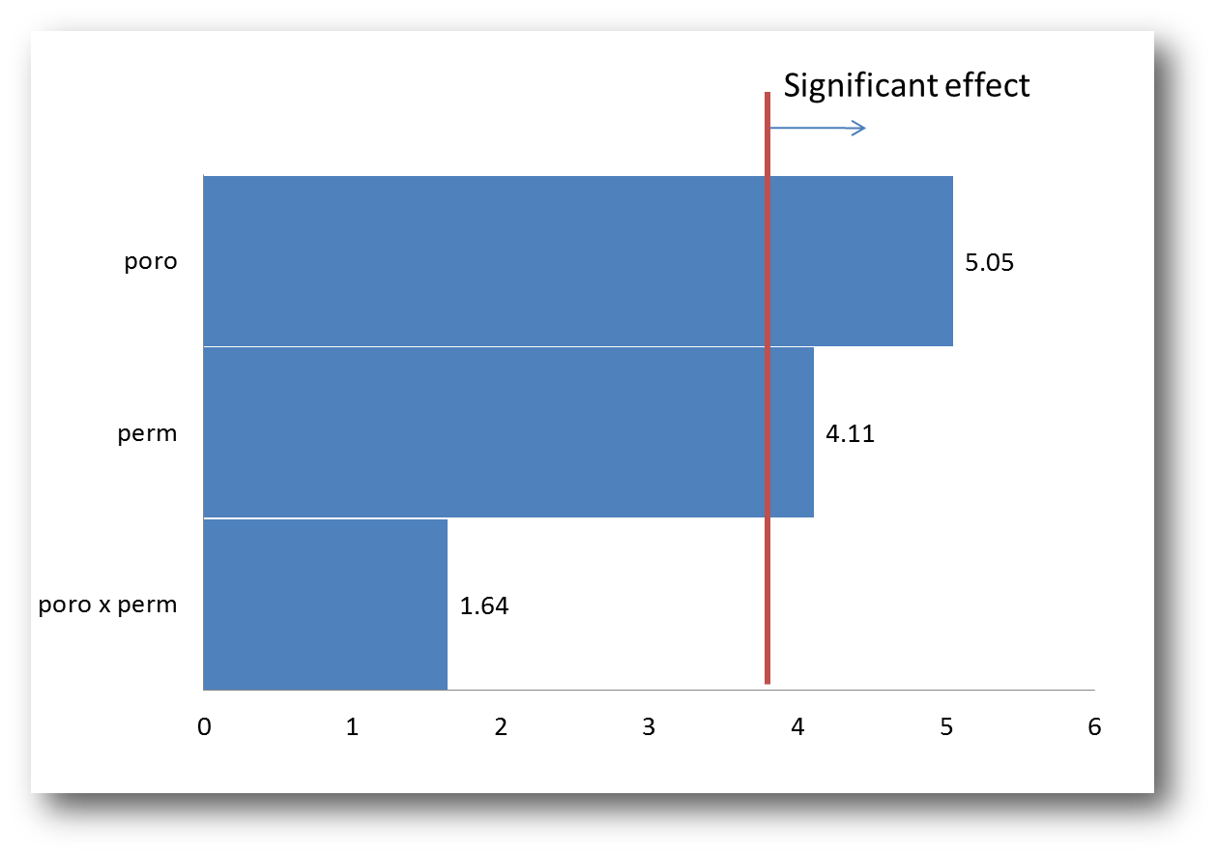
Effect estimates

Slide 17
Monte Carlo simulation using the response surface
Assume the response surface is a good approximation of the actual response
Perform Monte Carlo simulation of the input parameters
For each sampled parameter set, calculate the response using the response surface

Slide 18
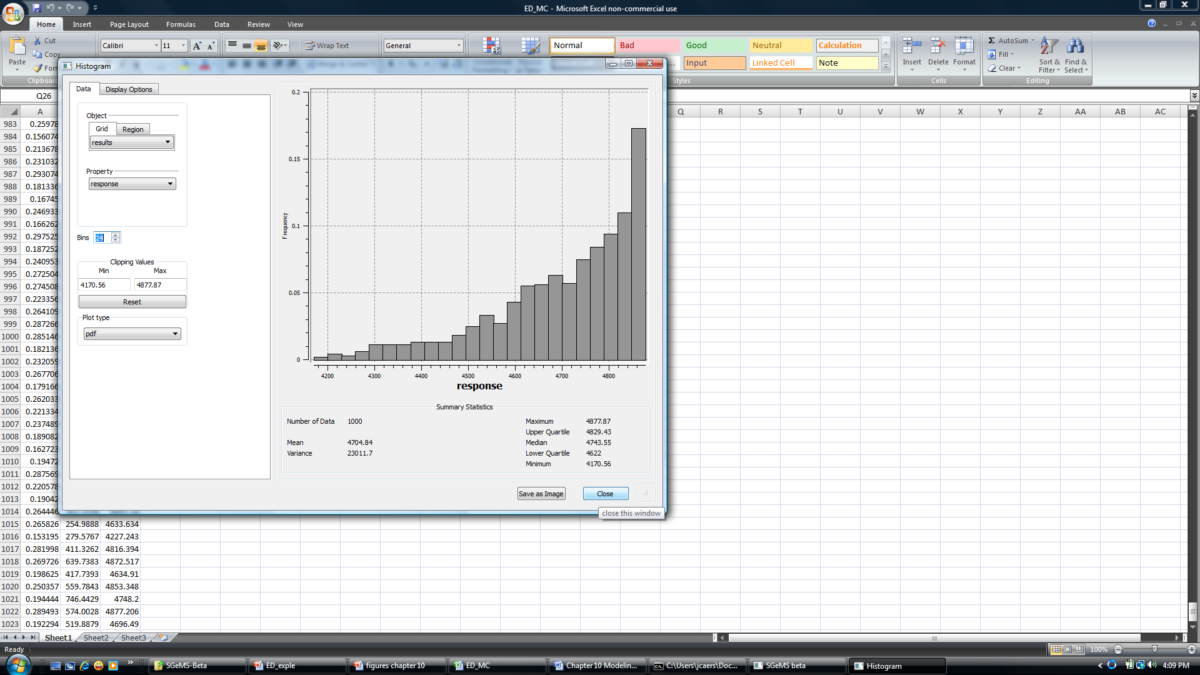
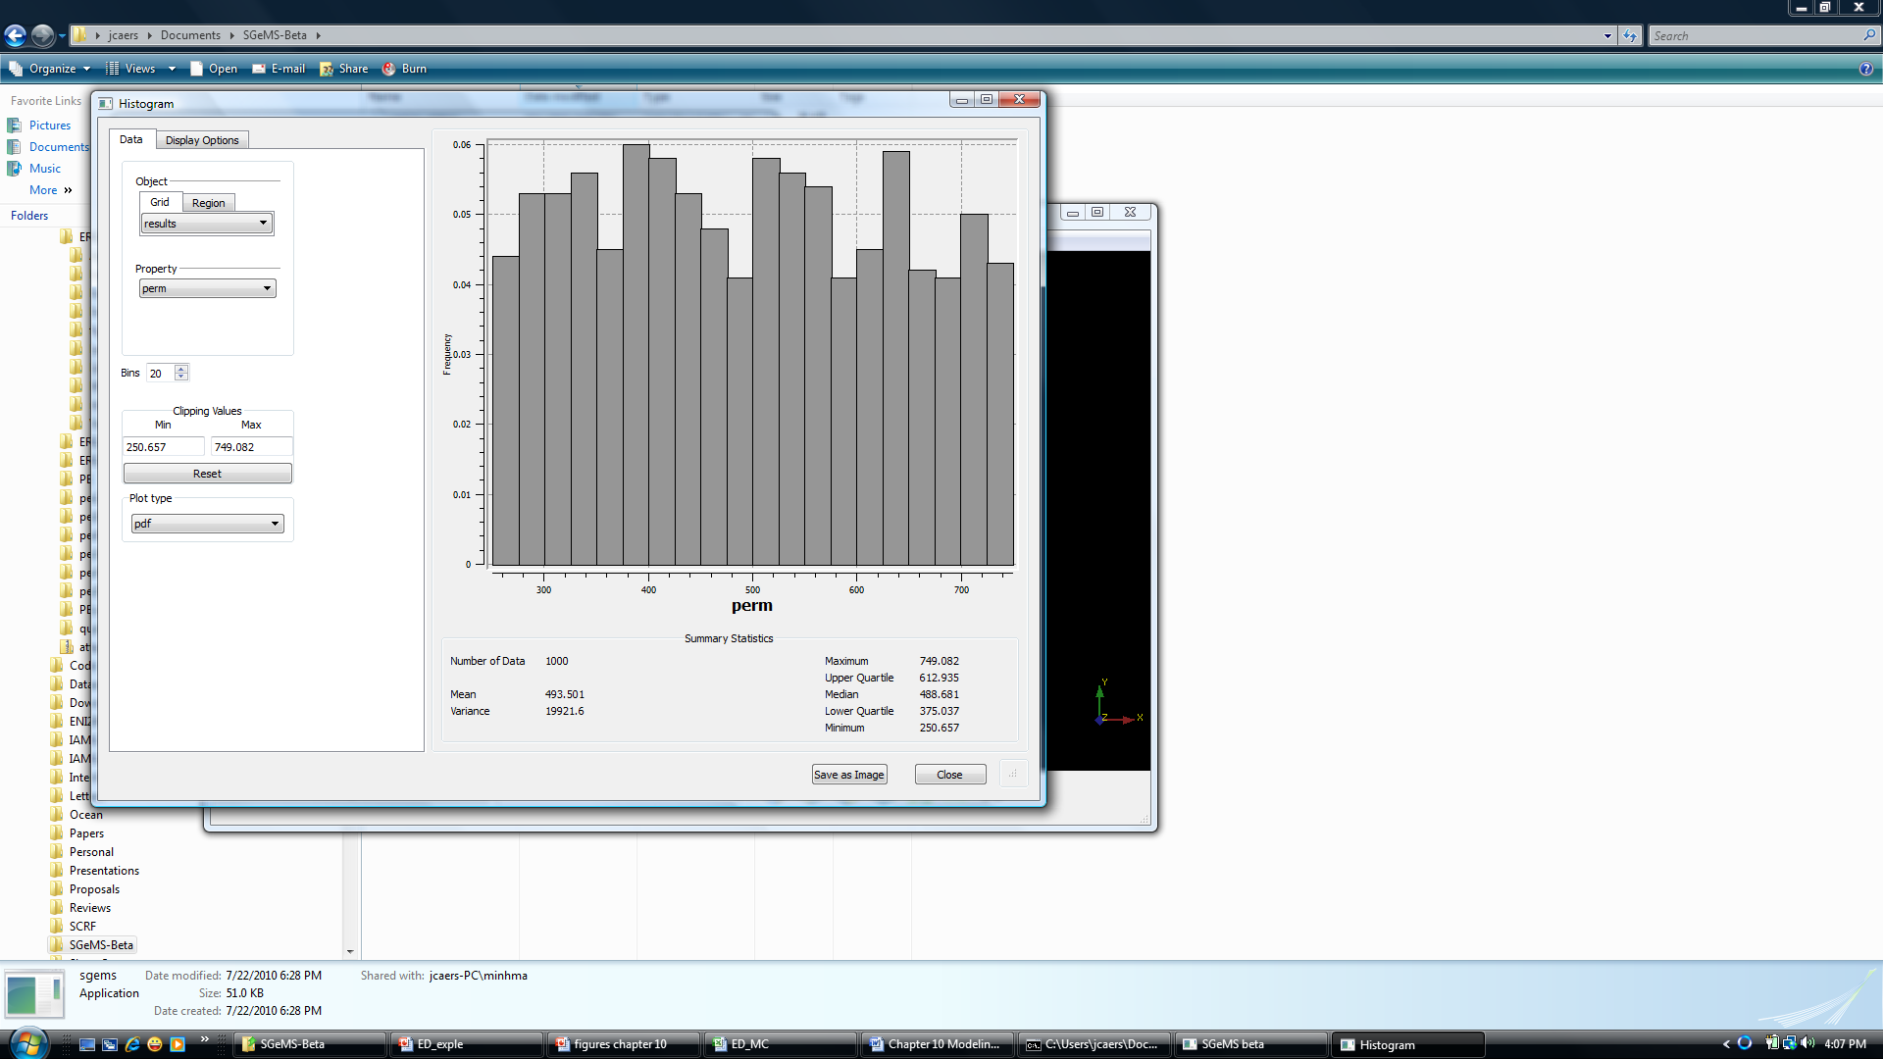
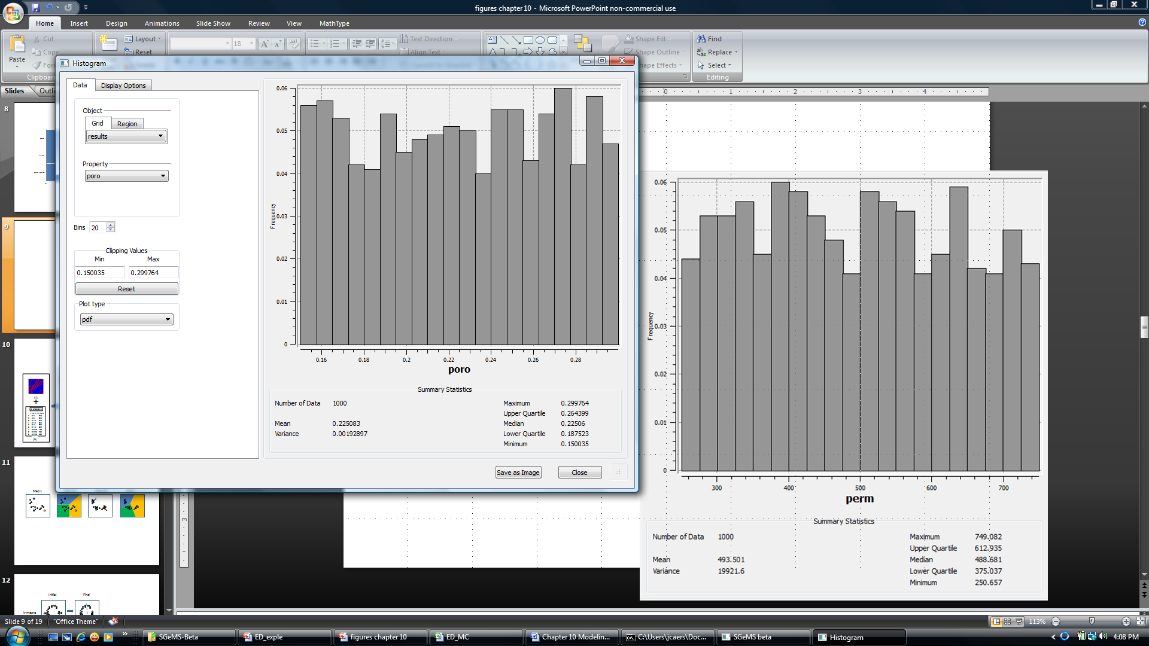
Result

Slide 19
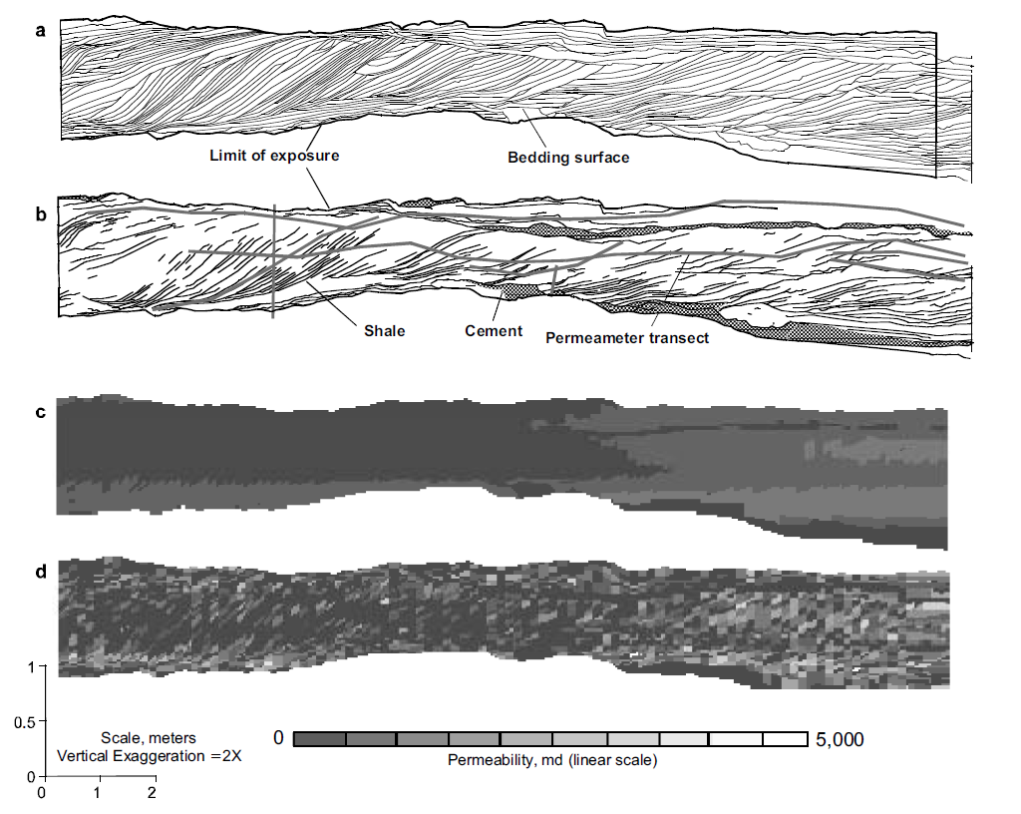
Experimental design: example
layering
Shale
Calcite cement
Permeability
(sgsim)
From White et al, SPE Journal
Notes:
An example of a complex outcrop that is modeled with shale layers as well as cementation due to bedding and continuous properties that are modeled with a variogram, the top figures show show the shale, the bottom the permeability, horizonatal and vertical

Slide 20
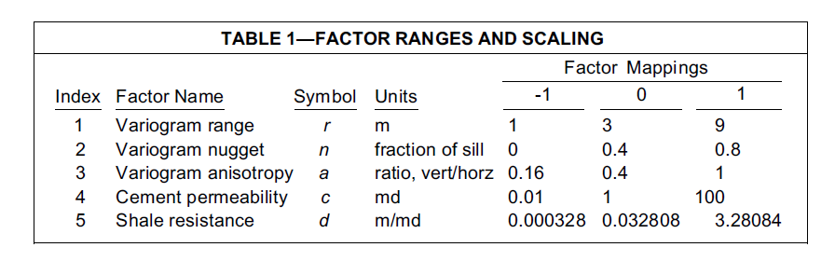
Factors considered
Notes:
Tha various factors considered and tre choice for low/medium/high

Slide 21
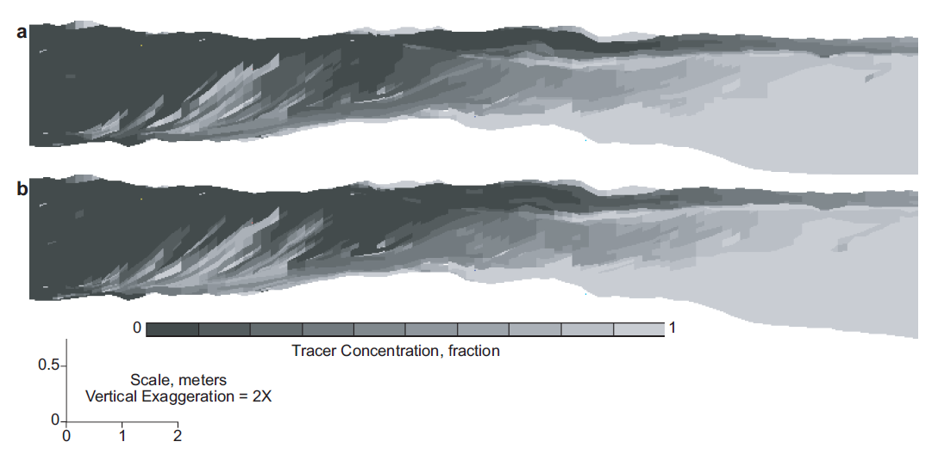
Response evaluation
Inject tracer (a dye basically)
Check when tracer arrives
Notes:
Reponse analysis is a tracer injected on the right and as response we measure the arrivalk time on the right

Slide 22
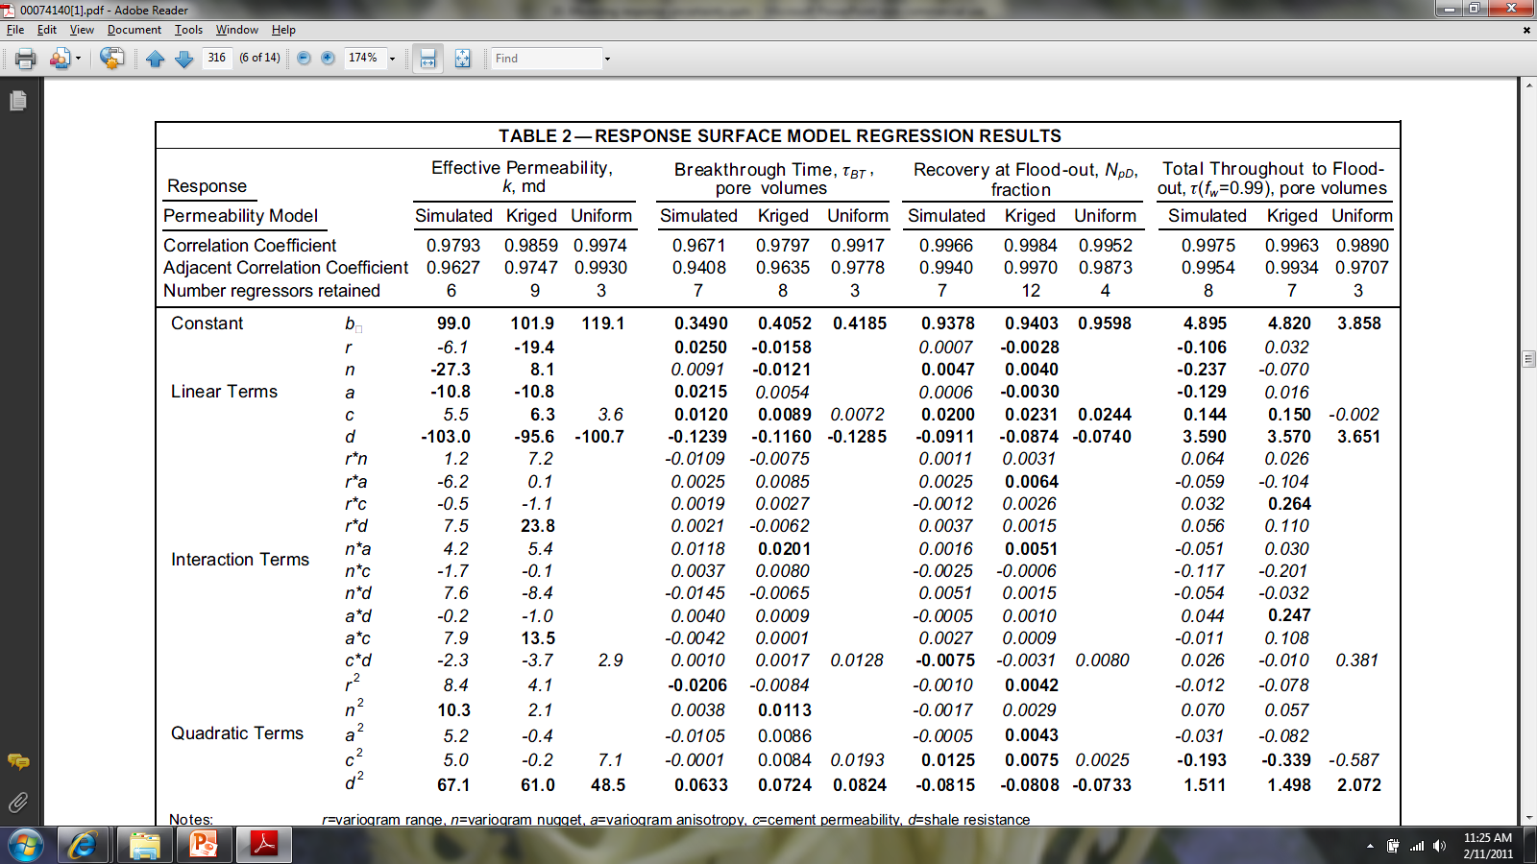
Effects estimate
Effect estimate on
tracer arrival time
Parameters
r = variogram range
n = nugget
a = anisotropy
c = cement permeability
d = shale resistance

Slide 23
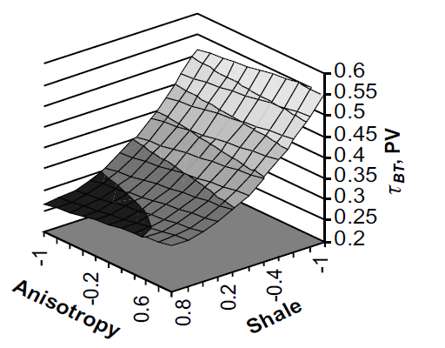
Response surface
Tracer arrival time
Notes:
Example response surface

Slide 24
Limitations
Works well for continuous, simple parameters, e.g. permeability in channel, depth of water table, variogram range
Cannot deal with spatial uncertainty, only “input uncertainty”
Not suited for scenario parameters such as the choice of a training image or choice of scenario (with shale/without shale)
Not suited for parameters that induce a discrete and/or discontinuous change in the response

Slide 25
Distance methods
Reponses that exhibit discrete changes
Parameters that may have major impact on uncertainty, such as the choice of a training image
Can be used with any parameters

Slide 26
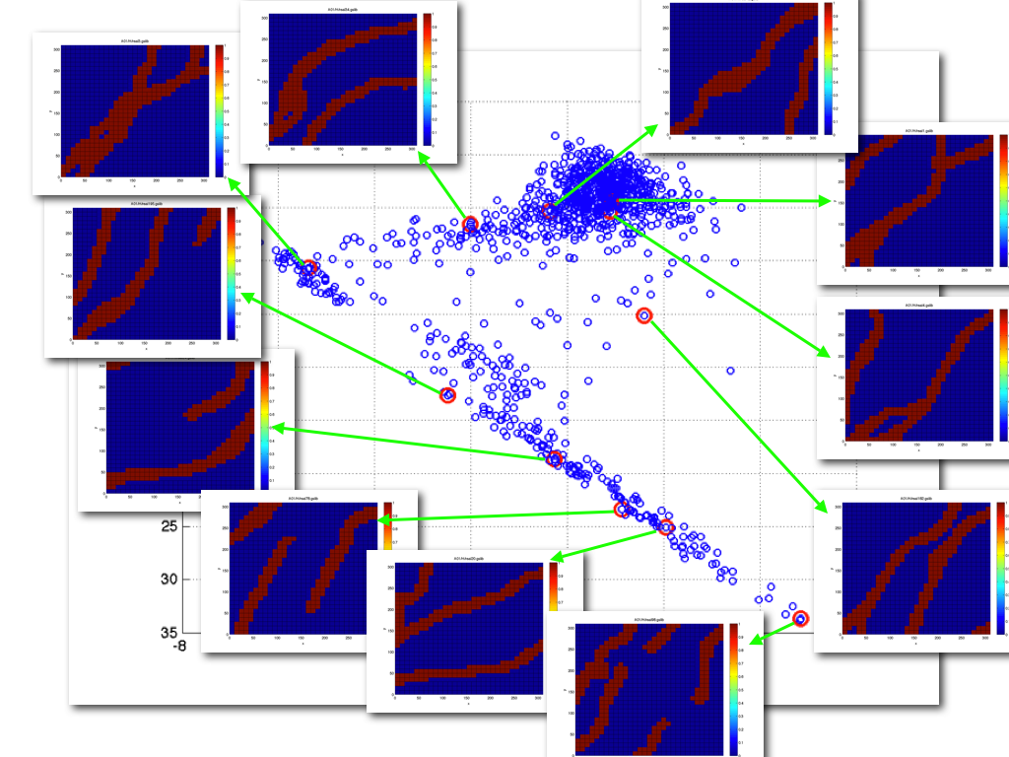
Recall chapter 9

Slide 27
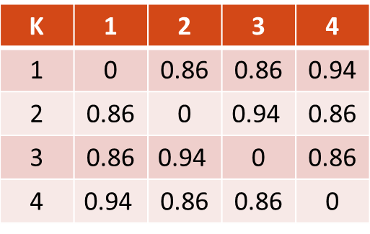
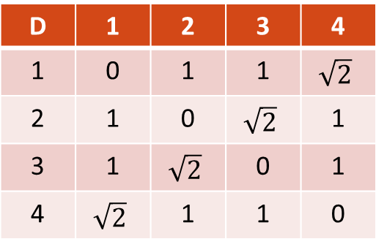
Do a simple transformation
distance
new distance
D | 1 | 2 | 3 | 4
1 | 0 | 1 | 1 | $$\sqrt{2}$$
2 | 1 | 0 | $$\sqrt{2}$$ | 1
3 | 1 | $$\sqrt{2}$$ | 0 | 1
4 | $$\sqrt{2}$$ | 1 | 1 | 0
K | 1 | 2 | 3 | 4
1 | 0 | 0.86 | 0.86 | 0.94
2 | 0.86 | 0 | $$\text{0.94}$$ | 0.86
3 | 0.86 | $$\text{0.94}$$ | 0 | 0.86
4 | $$\text{0.94}$$ | 0.86 | 0.86 | 0
k= 1-exp(-d)
λ₁ = λ₂ = 1
λ₃ = λ₄ = 0
λ₁ = λ₂ = 0.44
λ₃ = 0.31
λ₄ = 0

Slide 28
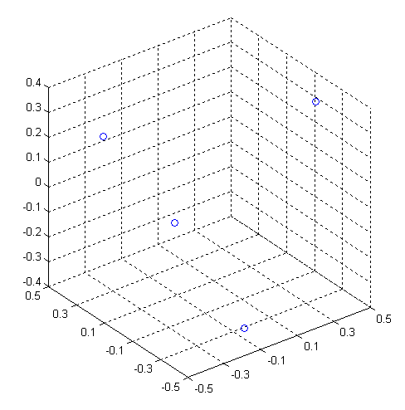
Linear separation is possible
4
1
3
2

Slide 29
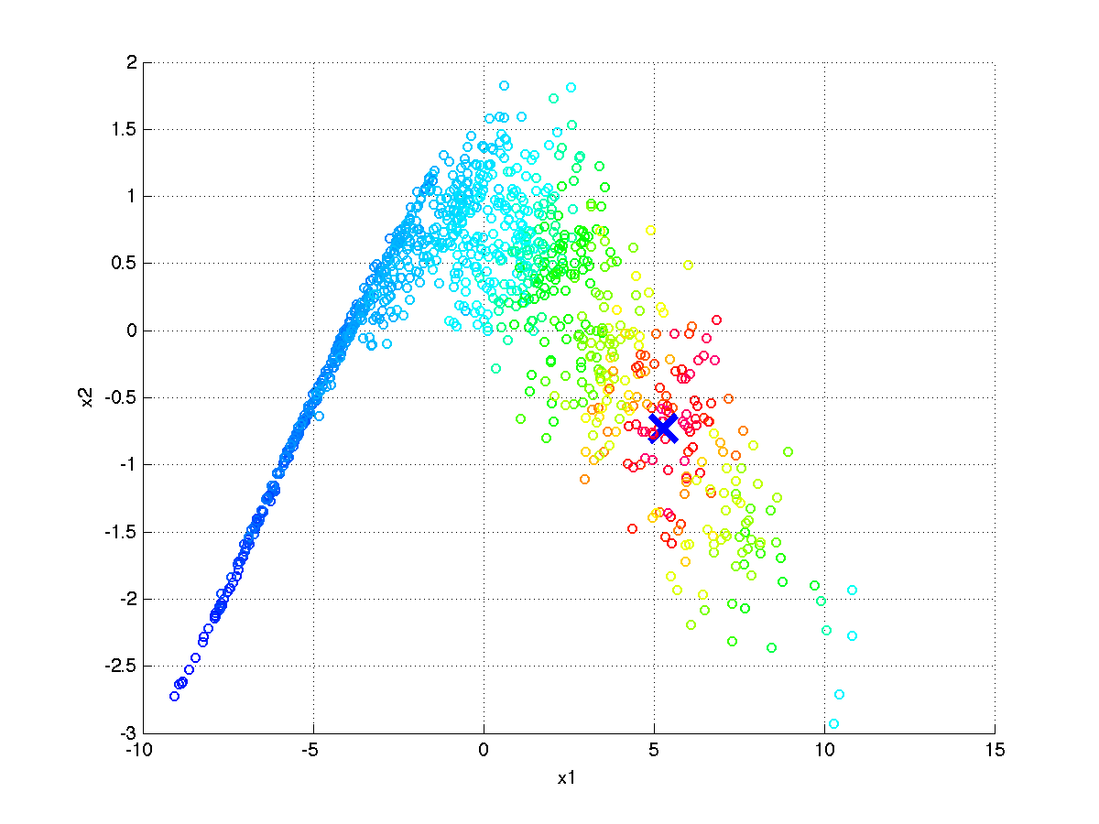
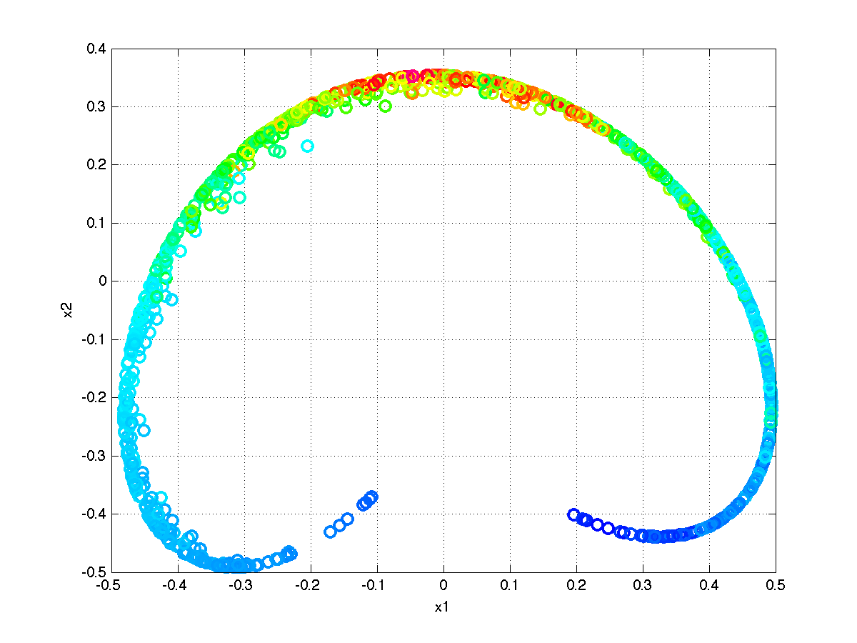
Kernel transformation
2D projection of models
From metric space
2D projection of models
in feature space
RBF Kernel
Making the map nicer and easier to work with

Slide 30
Idea
Find models with similar responses
Group them into a single “cluster”
Select a representative model for that cluster
Evaluate uncertainty by considering only the representative models

Slide 31
Clustering
Supervised clustering
Unsupervised clustering

Slide 32
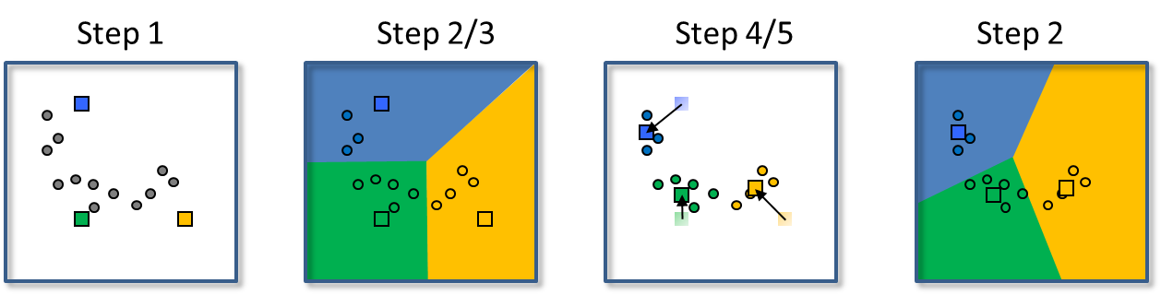
k-means clustering

Slide 33
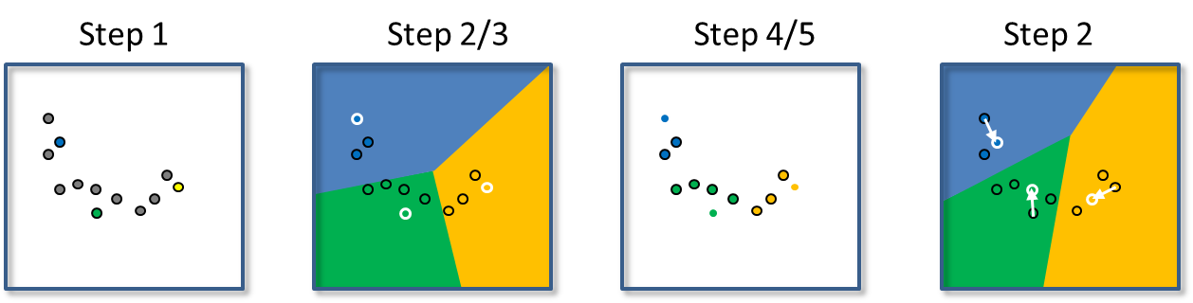
k-means versus k-medoid

Slide 34
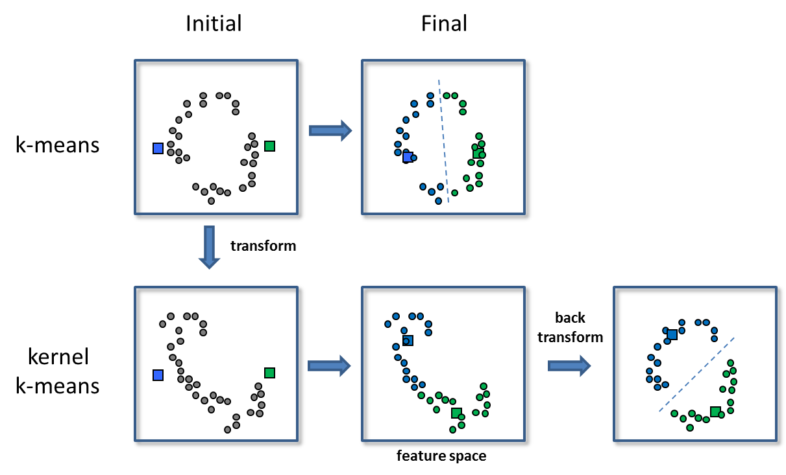
Kernel k-means or k-medoid clustering

Slide 35
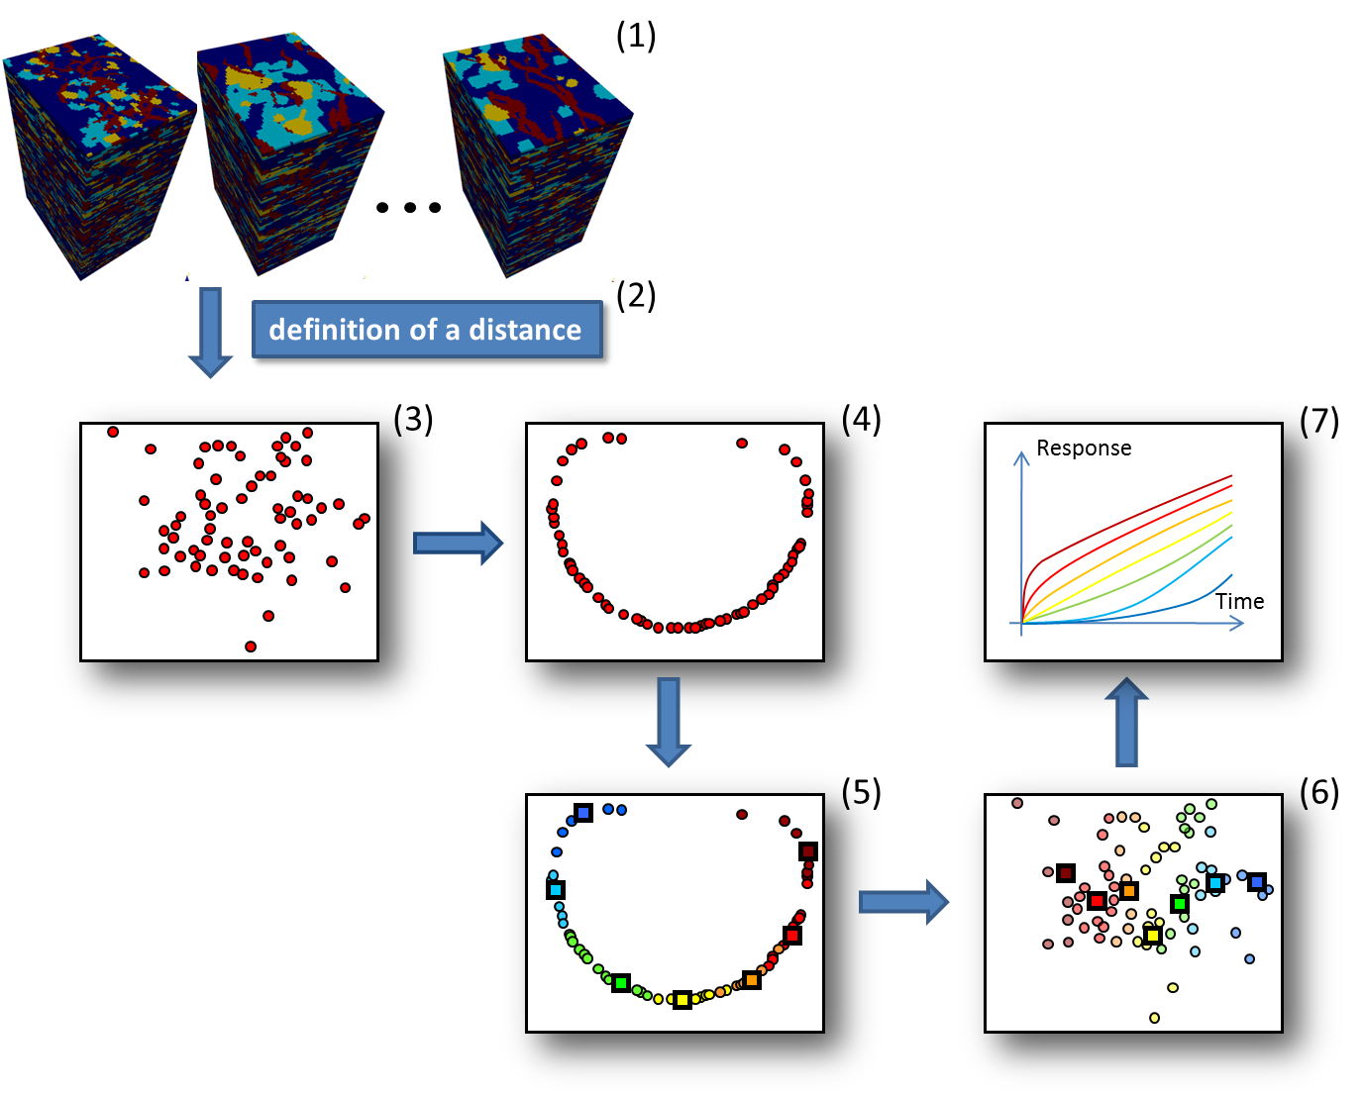
Clustering Earth models

Slide 36
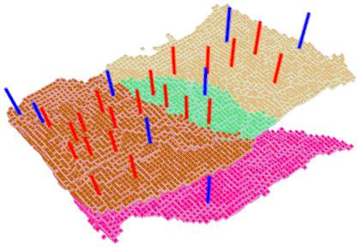
Case study
West-Africa deep water turbidite offshore reservoir
Dimensions of the reservoir model
78 x 59 x 116 gridblocks
28 wells
20 production wells (red)
8 injection wells (blue)
1 flow simulation = 3 hours

Slide 37
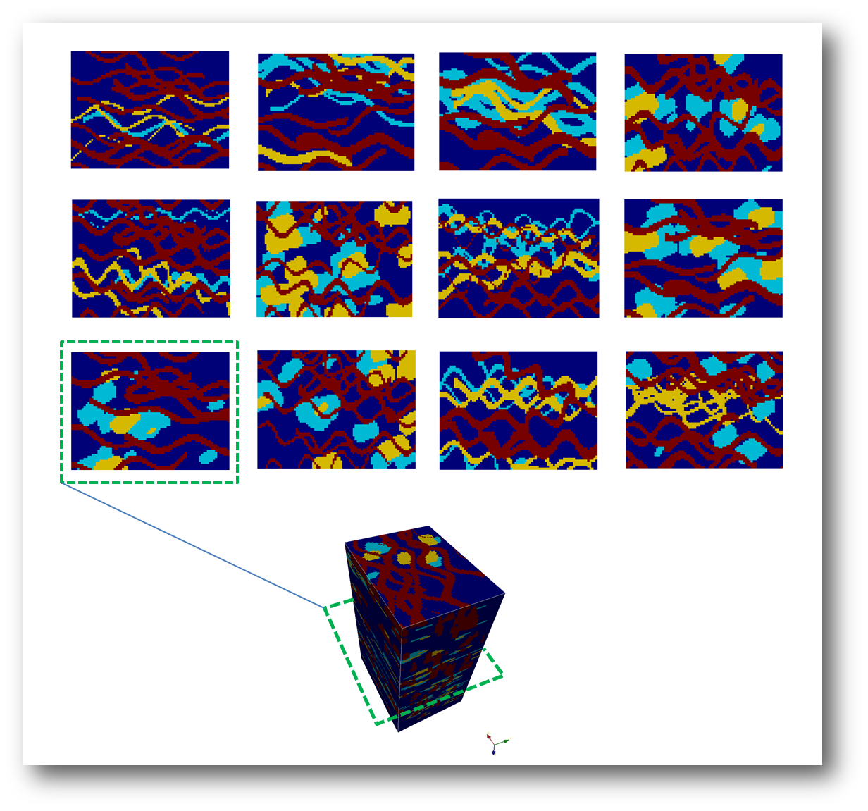
Model of spatial continuity
Uncertain about channels
Proportion
Channel width
Channel width/thickness ratio
Sinuosity

Slide 38
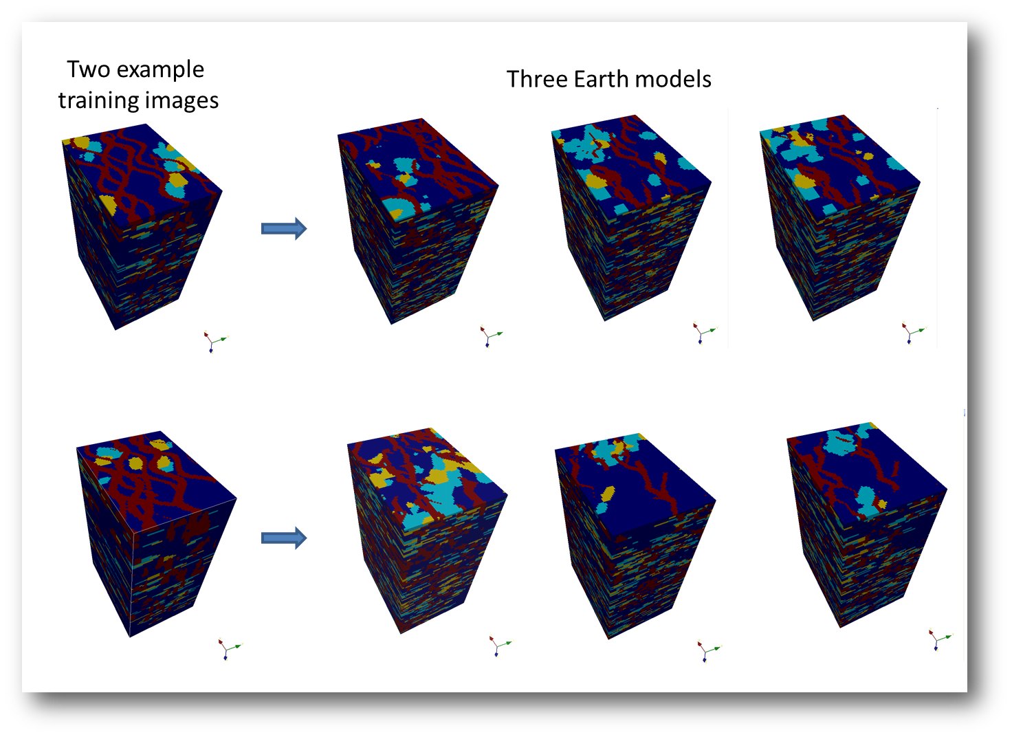
Spatial uncertainty

Slide 39
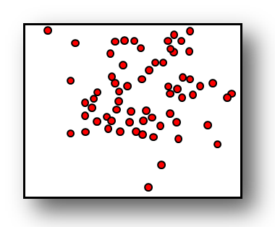
Distance
Use a fast flow simulator as an approximation
Define the distance based on the output of this fast flow simulator
Create map with MDS

Slide 40
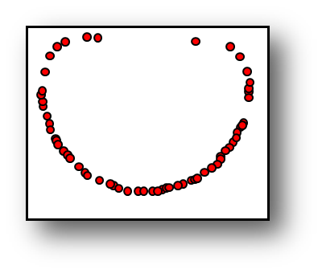
Kernel transformation

Slide 41
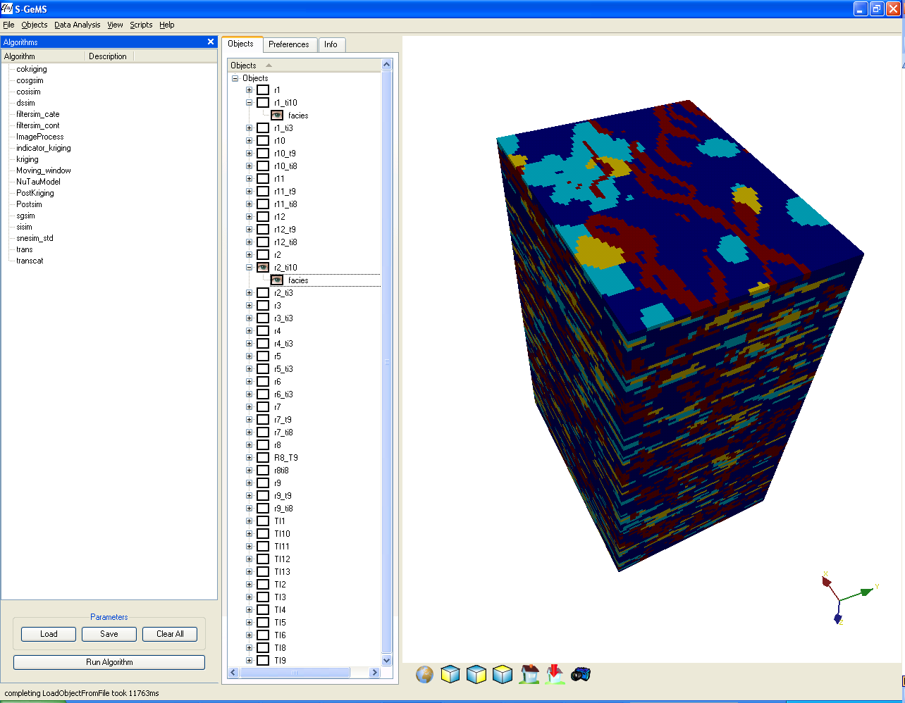
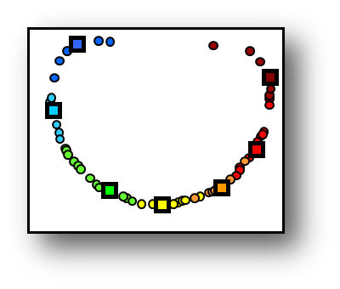
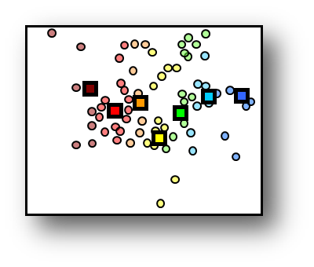
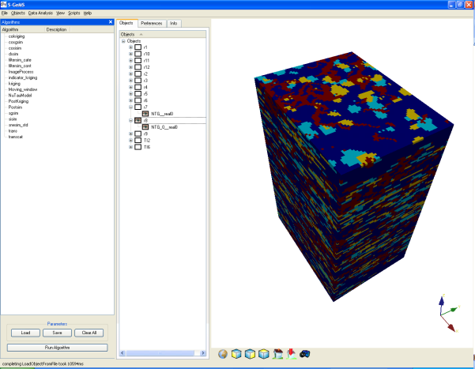
K-medoid Clustering

Slide 42
Response calculation
Response of 7 selected Earth models
Calculated P10, P50 and P90

Slide 43

Experimental design

Slide 44


Another application
Production
Parameters
Produced
Model
Test
Response
Made in Patagonia
Motorola
MDS
Made in USA
Samsung
Made in USA
Motorola
Made in Patagonia
Samsung
Made in USA
Motorola
Made in Patagonia
Samsung

Slide 45
Sensitivity analysis
MDS
Clustering
Samsung
Made in USA
Samsung
Made in Patagonia
Motorola
Made in Patagonia
Samsung
Made in USA
Samsung
Made in Patagonia
Motorola
Made in USA

Slide 46
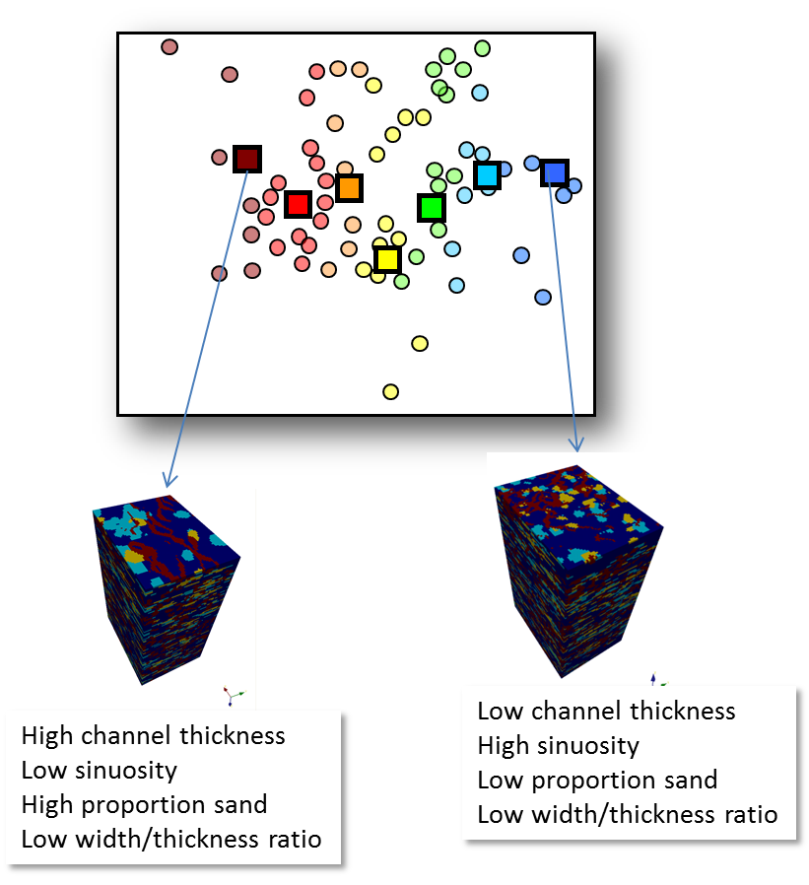
Experimental design

Slide 47
Experimental design
H = High
M = Medium
L = Low
Channel Thickness | Width Thickness Ratio | Channel Sinuosity | % Sand | Cumulative Oil at time “36” In 10⁴ MSTB
H | H | L | M | 8.5
H | H | H | H | 8.1
H | H | H | L | 7.6
M | L | L | M | 6.8
M | L | H | M | 6.1
L | H | L | L | 5.4
L | M | M | H | 5.1

Slide 48
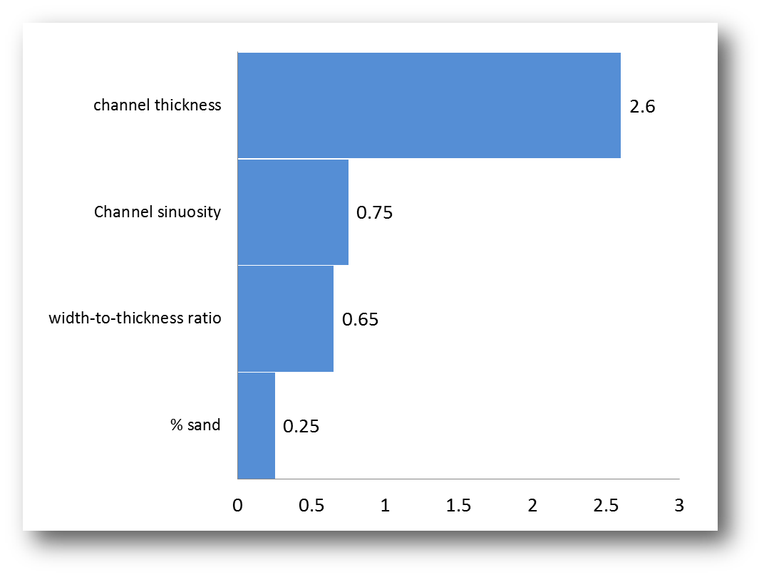
Effect estimates

